Slide 1
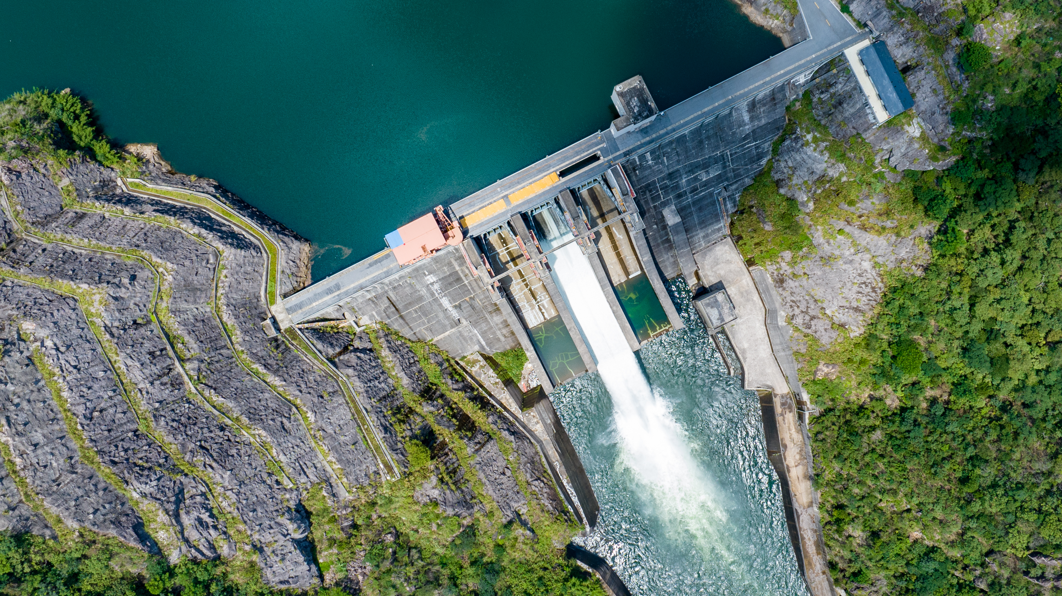
Webinar, 13 August 2024
Powering Europe:
Hydro Highlights & Market Trends

Slide 2

Powering Europe: Hydro Highlights & Market Trends
Q2 2024 with Q3 Outlook

Slide 3
Highlights Q2 and Outlook Q3
The Islands of Ireland and Great Britain
Phil Hewitt

Slide 4
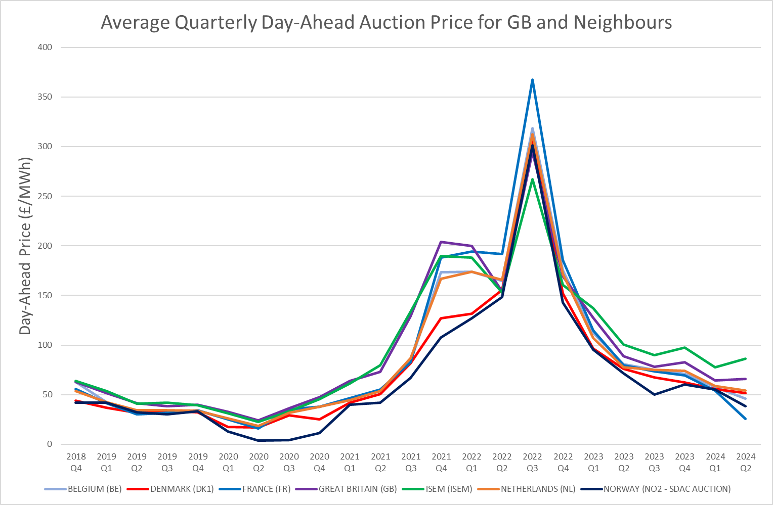
Day Ahead Prices
Ireland has been consistently higher than GB
GB Consistently Higher than the Continent

Slide 5
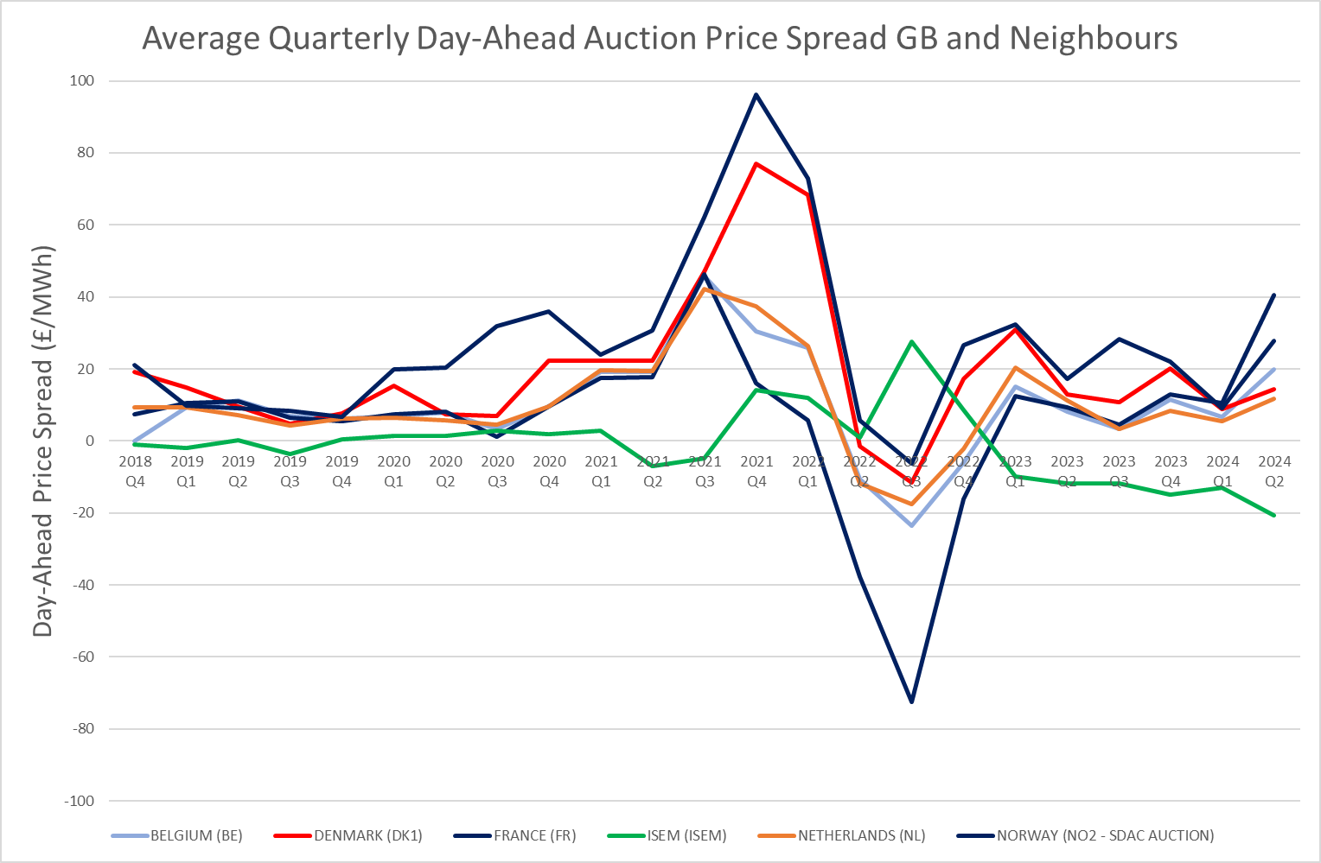
Day Ahead Price Spreads
Ireland has been consistently higher than GB
GB Consistently Higher than the Continent

Slide 6
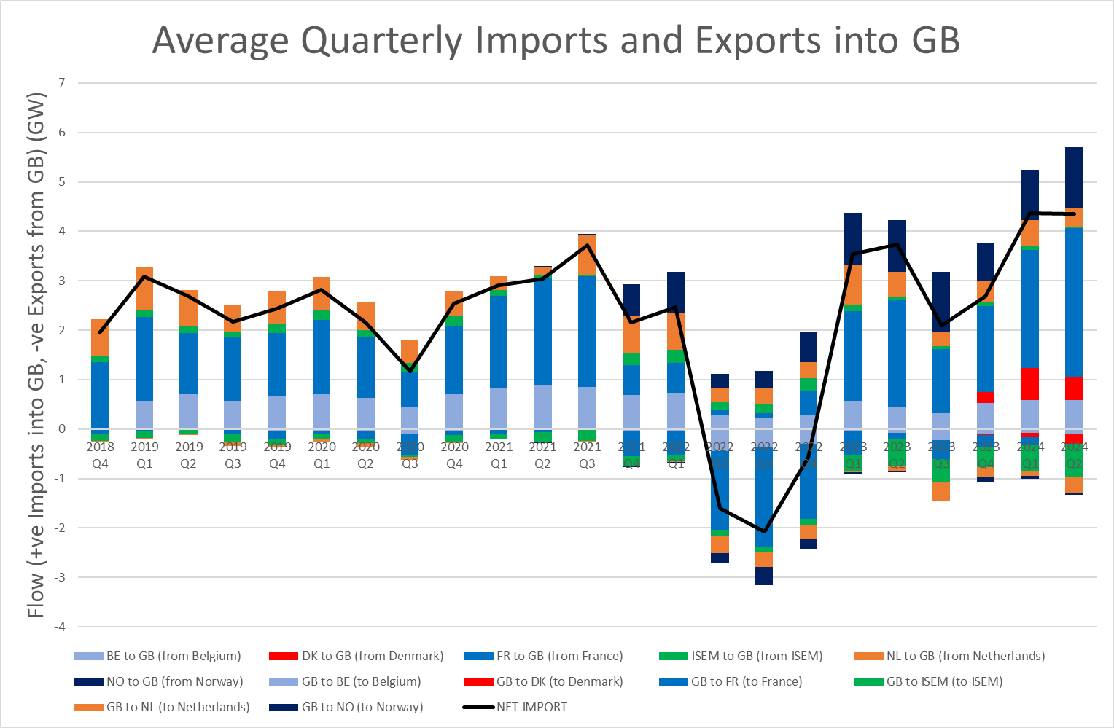
Interconnector Dispatch
Ireland has been consistently Higher than GB
GB Consistently Higher than the Continent
Results in Flows from Continent to GB and GB to Ireland
Why?

Slide 7
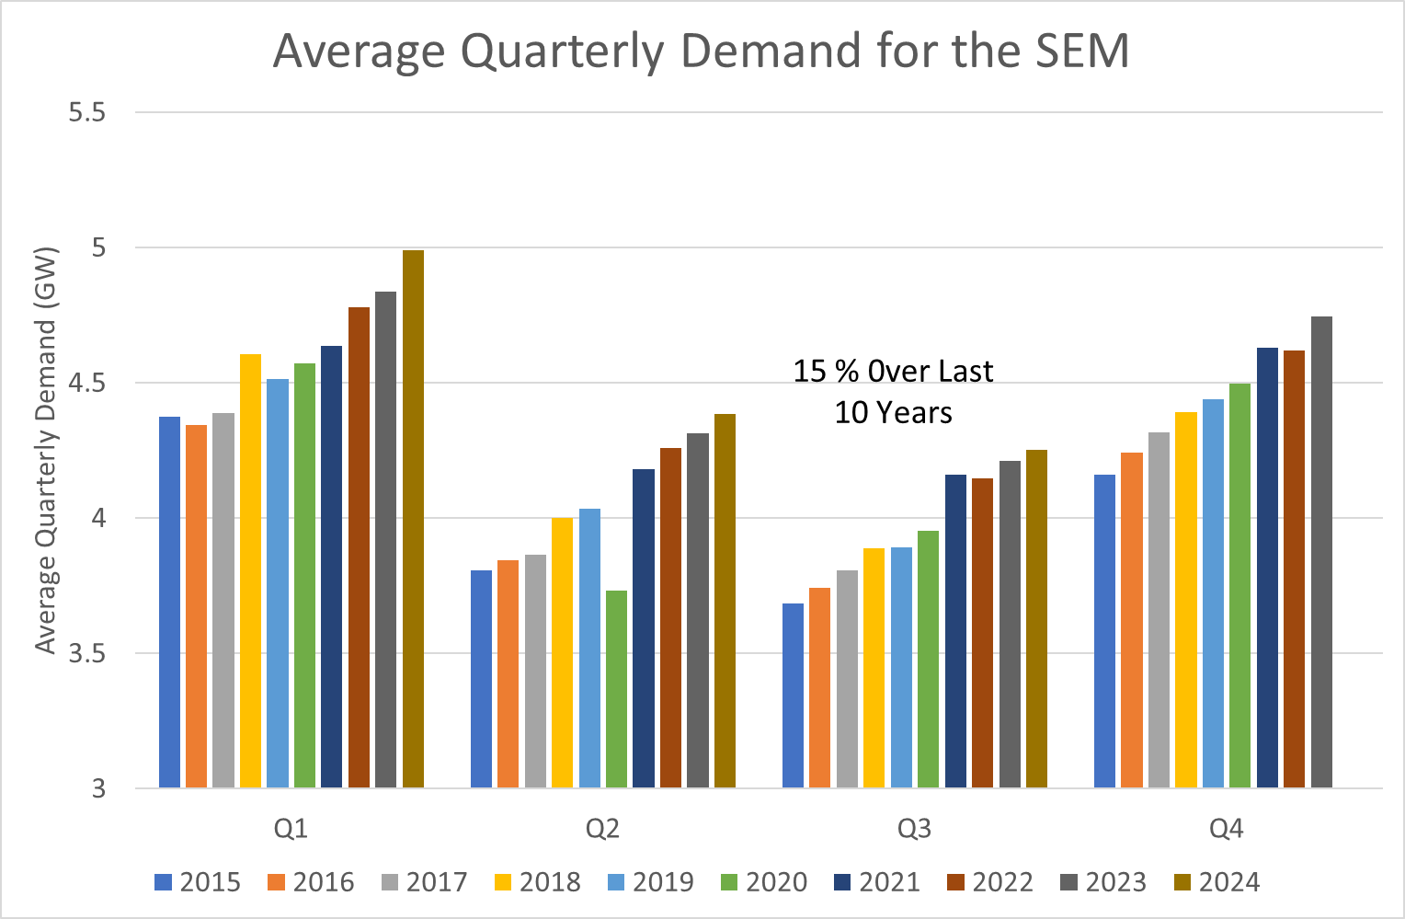
Why is the SEM more Expensive than GB?
Demand Has Increased
Year-on-Year at an average of 1.5% a year.
Data Center build out a big source of extra demand

Slide 8
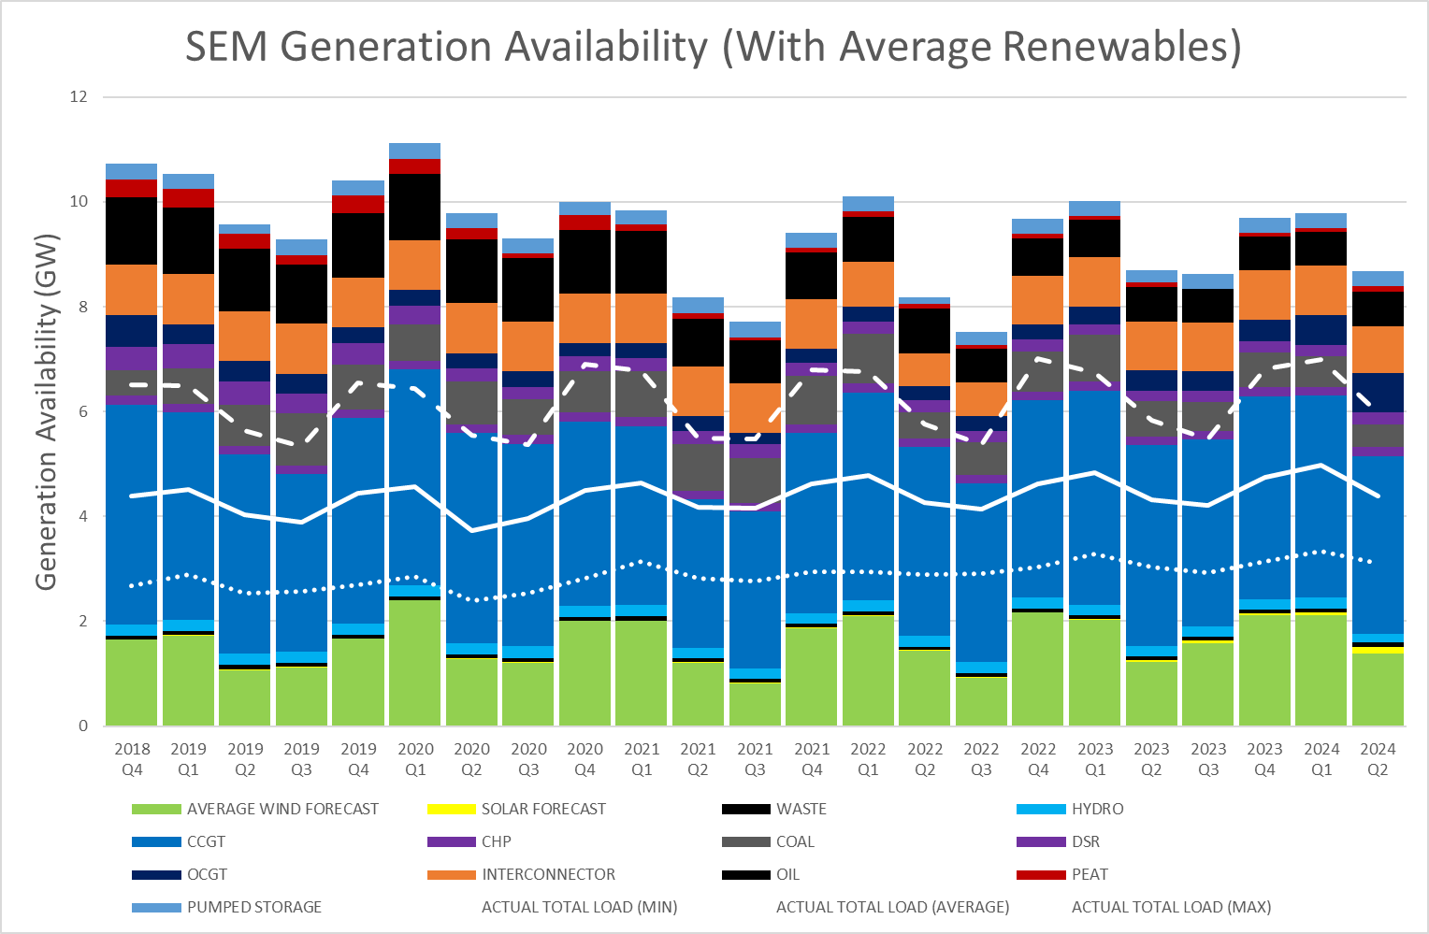
Why is the SEM more Expensive than GB?
Demand Has Increased Year-on-Year at an average of 1.5% a year.
Data Center build out a big source of extra demand
Generation Availability has decreased over the past 6 years

Slide 9
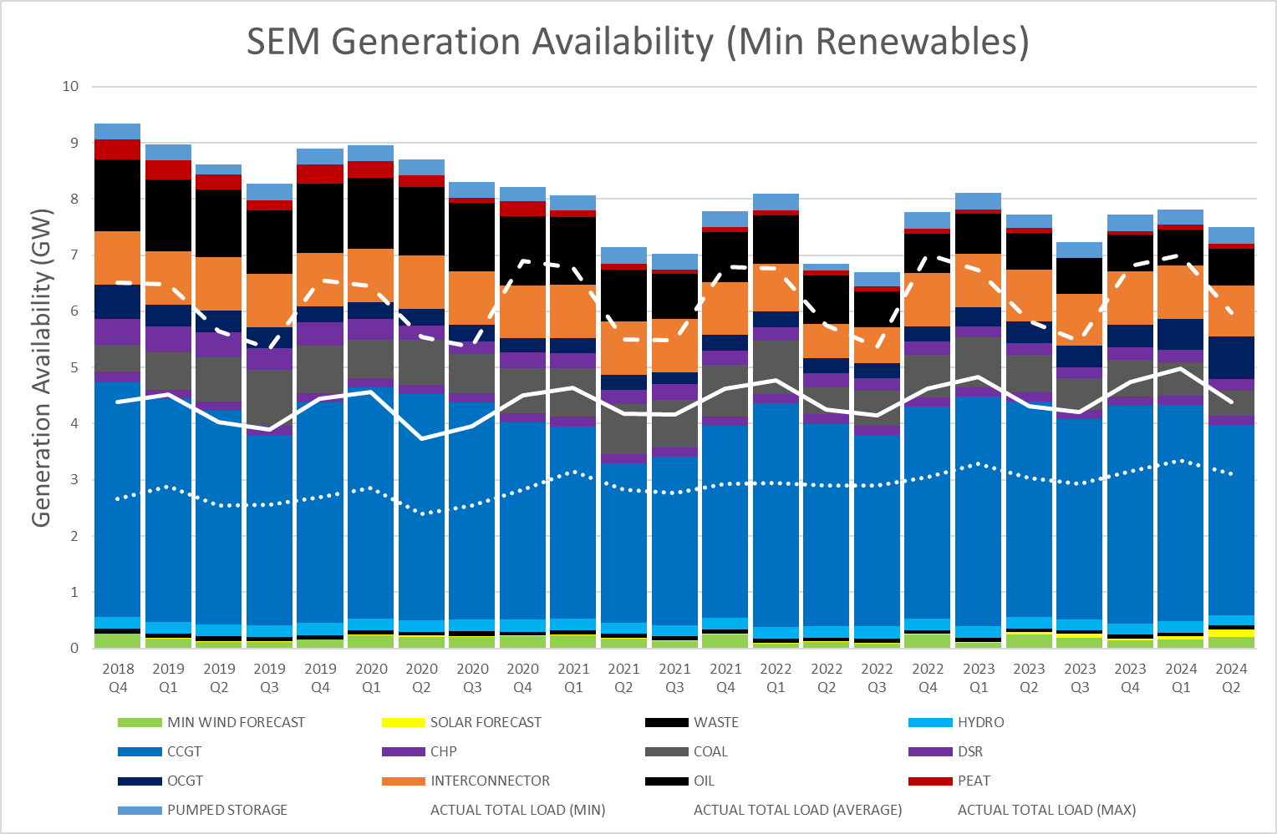
Why is the SEM more Expensive than GB?
Demand Has Increased Year-on-Year at an average of 1.5% a year.
Data Center build out a big source of extra demand
Generation Availability has decreased over the past 6 years
When the Wind does not blow prices go extreme

Slide 10
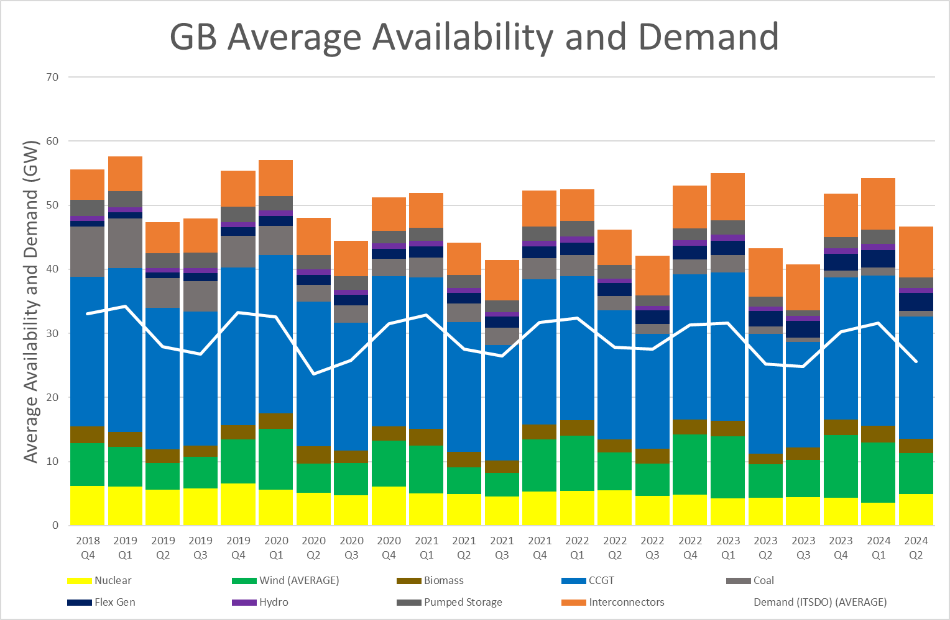
GB has not been exciting
On average power price in GB set by CCGT
Prices are therefore generally higher than renewable and nuclear countries and similar to countries using gas too like NL

Slide 11
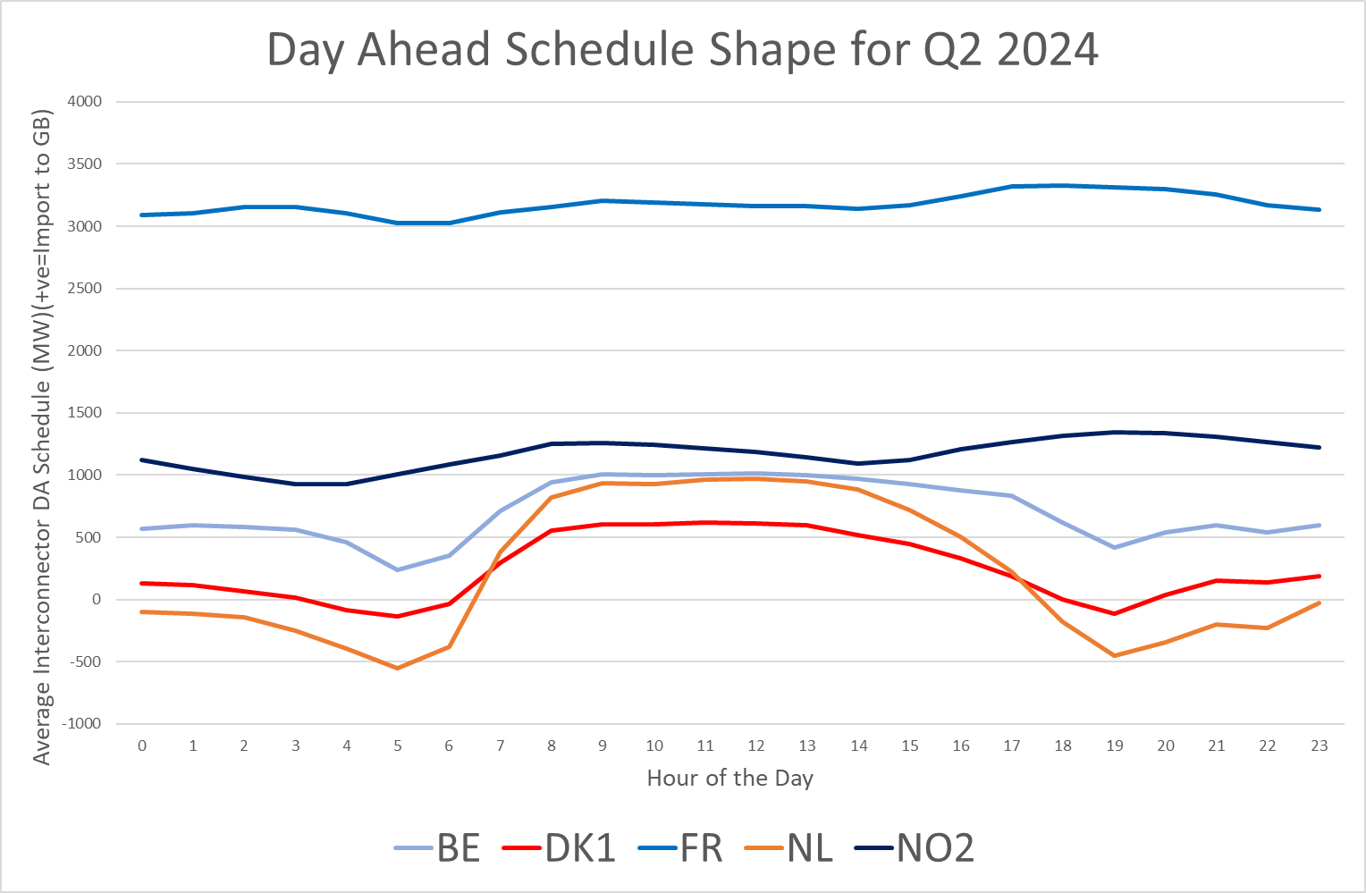
GB Flows from/to the Continent at the DA
France has super cheap Nuclear so exports baseload limited by IC Capacity
NO2 has super cheap Hydro so exports baseload limited by IC capacity
Belgium takes French Power and exports to GB so baseload(ish)
Netherlands is similar fuel mix to GB but with loads more solar so flips between imports from GB overnight and exports to GB during the day
Denmark sits between NO2 and Netherlands so its shape is the average of NO2 and NL.

Slide 12
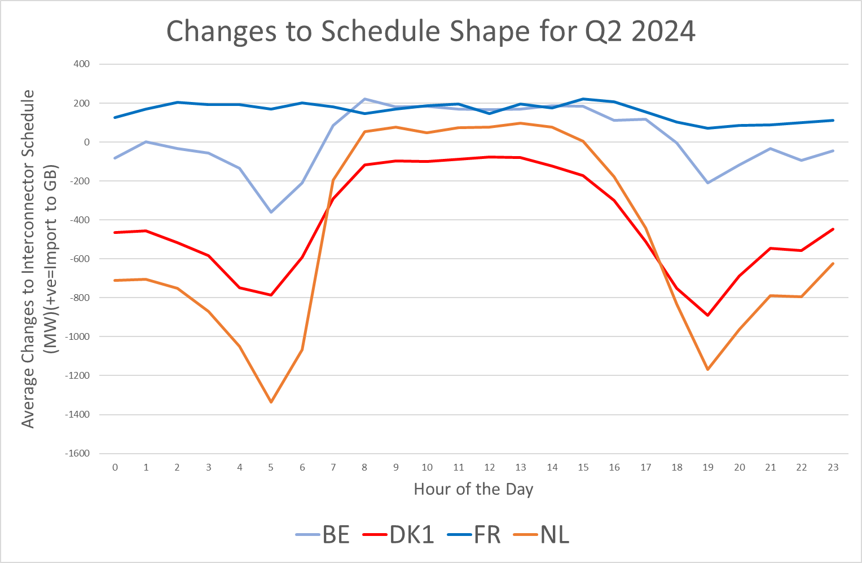
Changes to Schedule from DA to Delivery
France exports even more baseload
NO2 is not redispatchable after Day-Ahead
Belgium takes French Power and exports to GB in the day but uses GB power to balance in the morning and evening peak
Netherlands and Denmark use GB power to balance the morning and evening. Related to renewable delivery deltas?
More analysis needed to catch NG ESO trading

Slide 13
Upcoming Trends for Q3 and Q4
GB won’t change much in Q3
Severn Power and Sutton Bridge are coming back in Q3 / Q4 meaning that more CCGTs in the market reducing risk of extreme prices
Volatility in gas prices could start to reverse interconnectors into Europe
New Labour Government will not have an effect in the short term
Q4 sees the arrival of another 500MW Greenlink interconnector
Solar Build out in Ireland is happening at pace

Slide 14
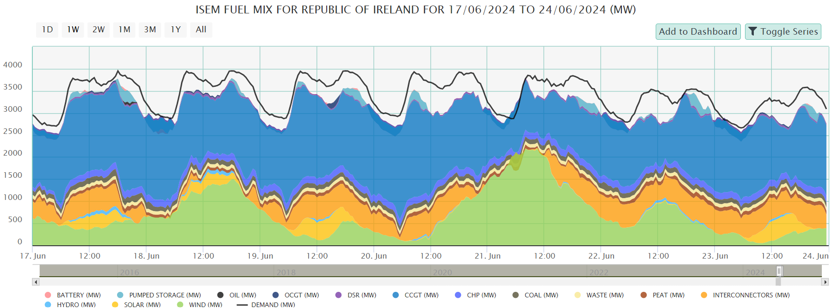
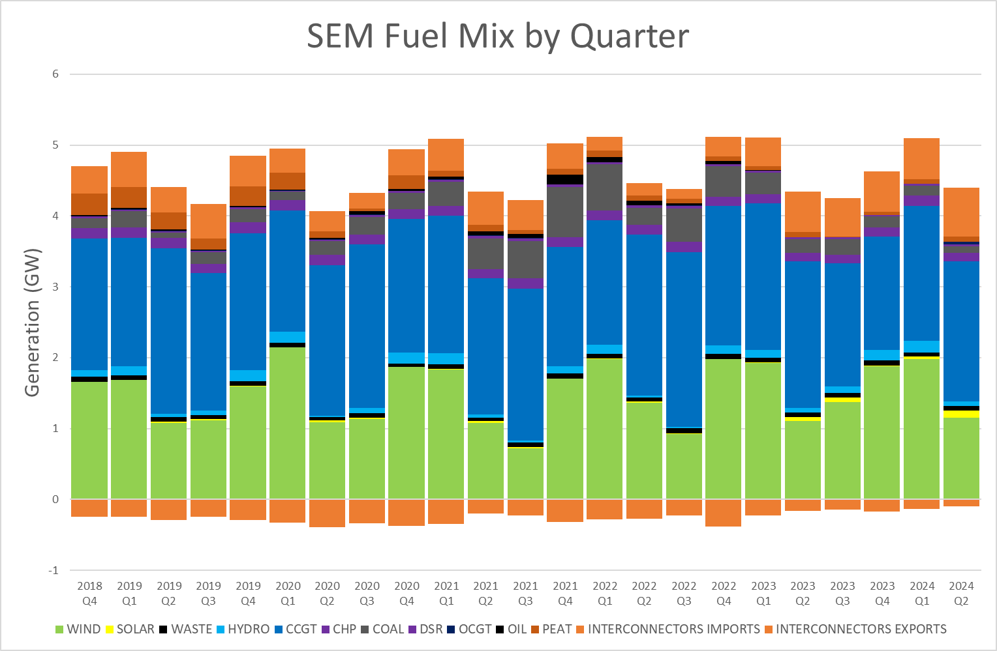
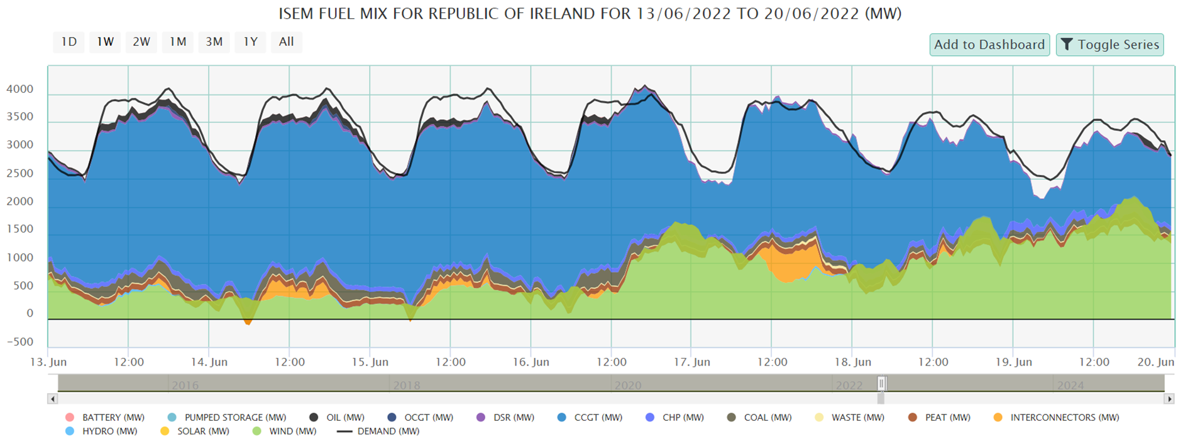
Solar Build Out in Ireland – More in Q3
June 2024
June 2022

Slide 15
Highlights Q2 and Outlook
France
Clement Bouilloux

Slide 16
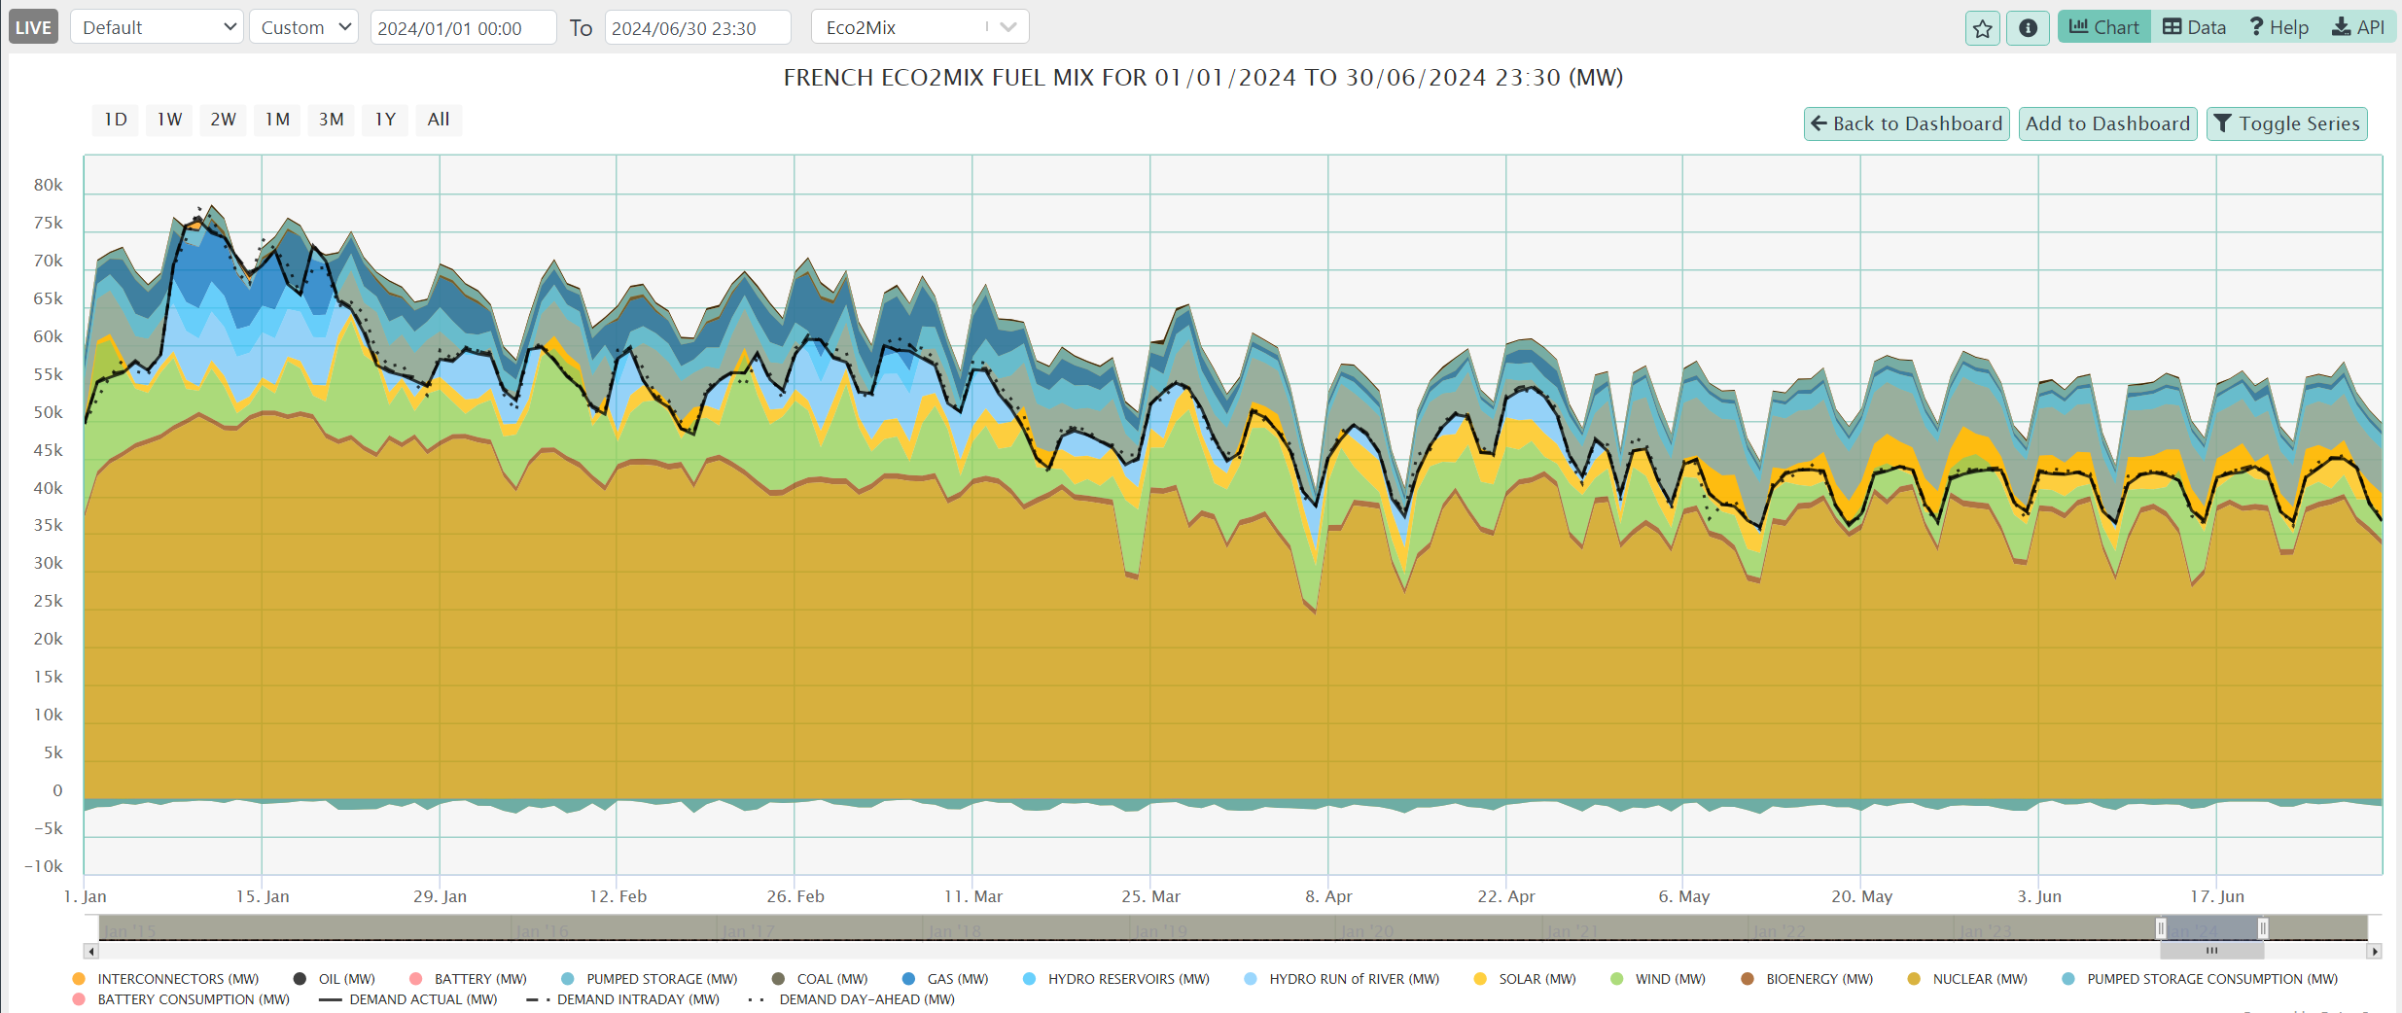
First semester – French Fuel Mix
Exports: 40.8 TWh
177 TWh

Slide 17
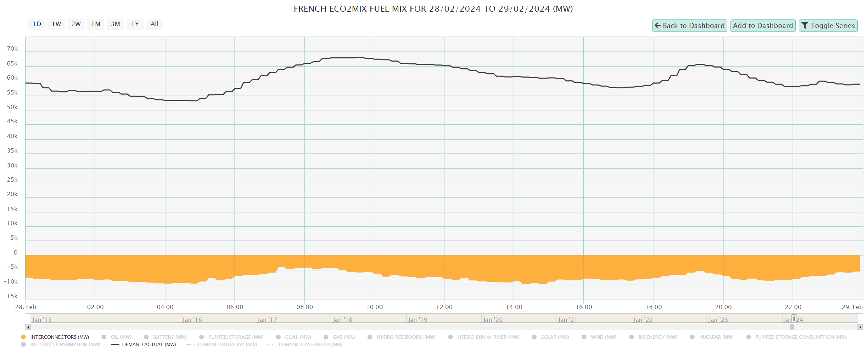
Typical Day - 28th of February
9.5 GW
4 GW
10 GW
5.4 GW
8.8 GW

Slide 18
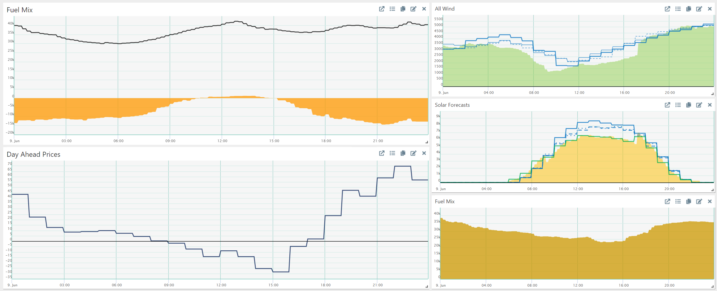
Low Price Day: 9th of June
DA negativ
Import
35 GW
36 GW
23 GW

Slide 19
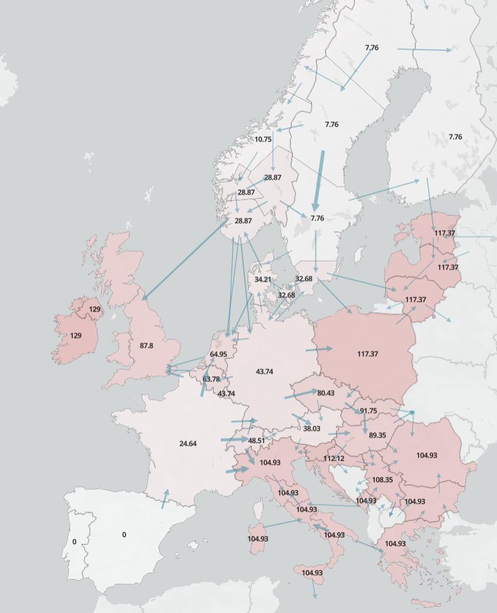
Q4 and later
Depreciated load, until when?
Nuclear to reach EDF target 315-345TWh
Export curbs & Price Impact
Renewables: Wind, Solar and Hydro

Slide 20
CWE Hydrology Highlights
Eylert Ellefsen

Slide 21
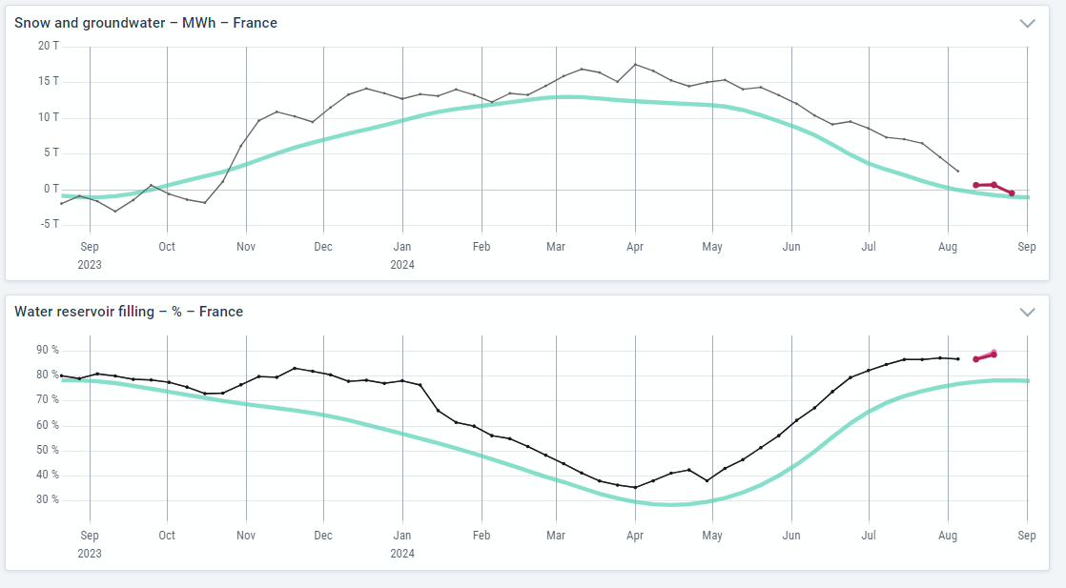
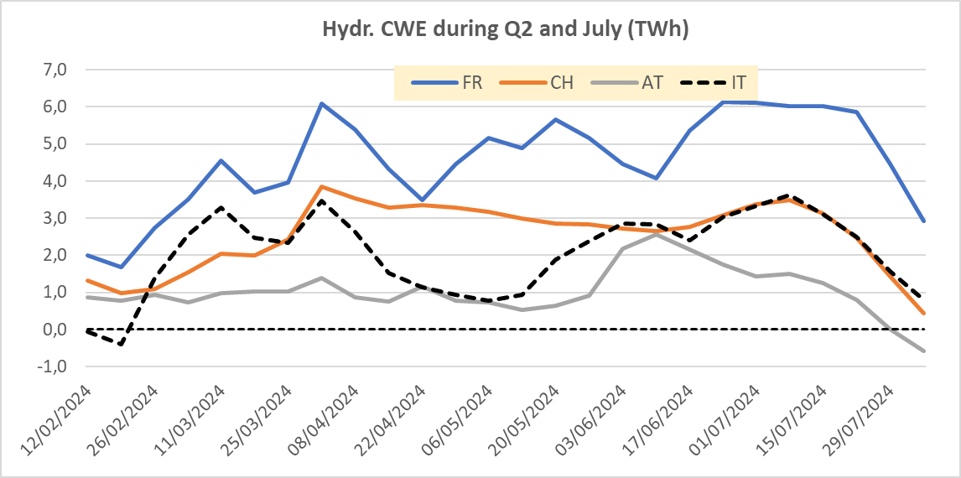
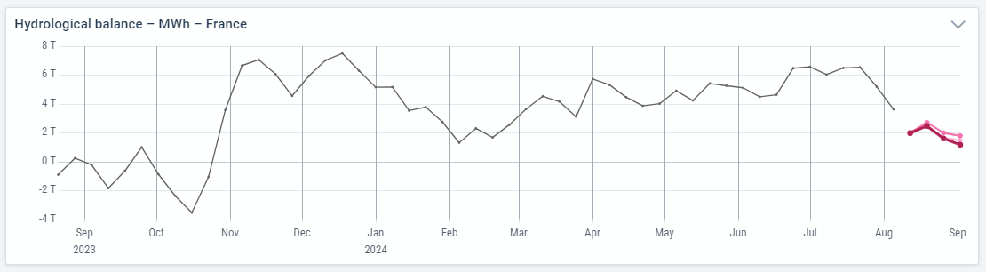
Hydrology France and CWE Q2 and Q3 development
Hydrological balance in France and Alp Region improved strongly during Q4-23, and has stayed higher than normal during H1-2024, partly at “alltime-high”. Thus hydropower production has been rather strong during Q2. August will be drier than normal, and hydr. balance in the Alp region is normalizing these days
France has been the main surplus area of hydropower in the Alp Region.

Slide 22
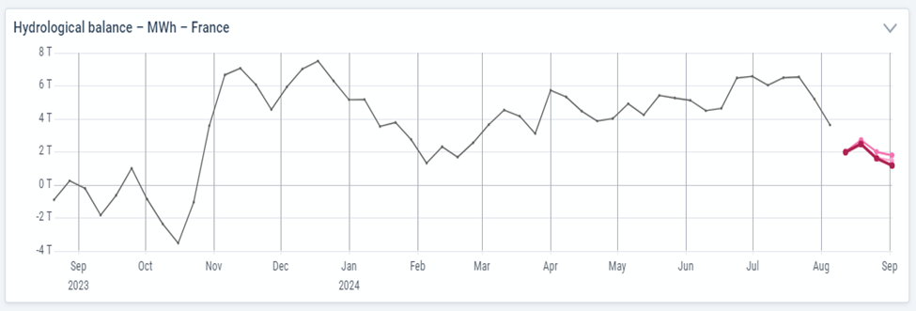
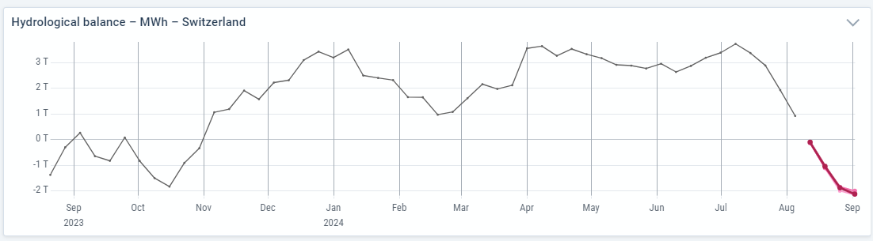
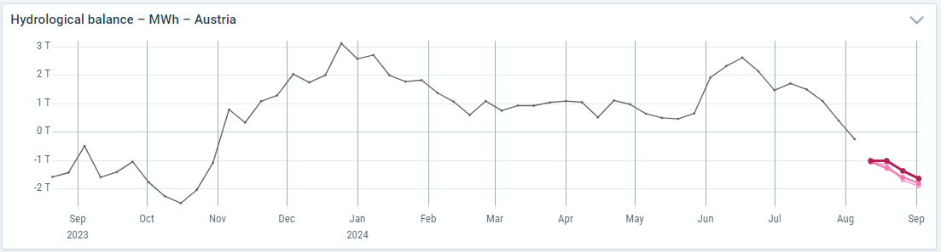
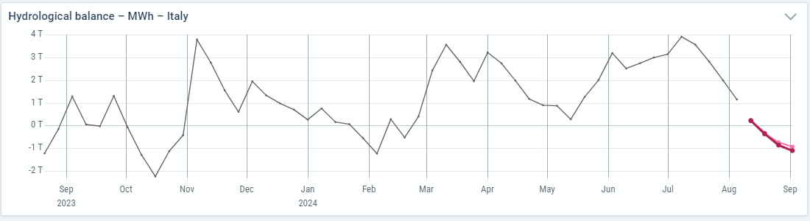
Hydrological balance in the Alp Region since Q4-23
Max hydr. Bal CWE = 14 TWh July 1st, forecast Sept 1st is – 3 TWh due to dry July and August

Slide 23
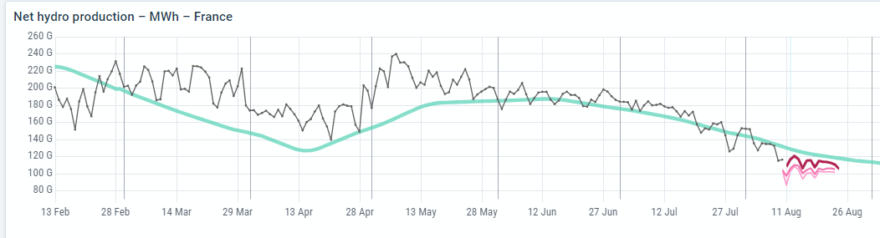
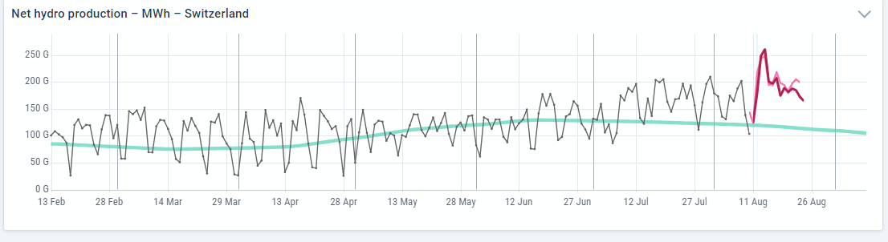
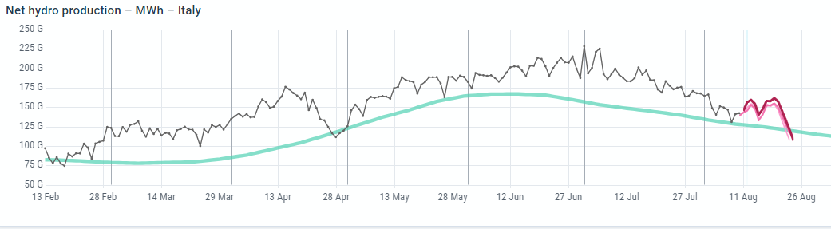
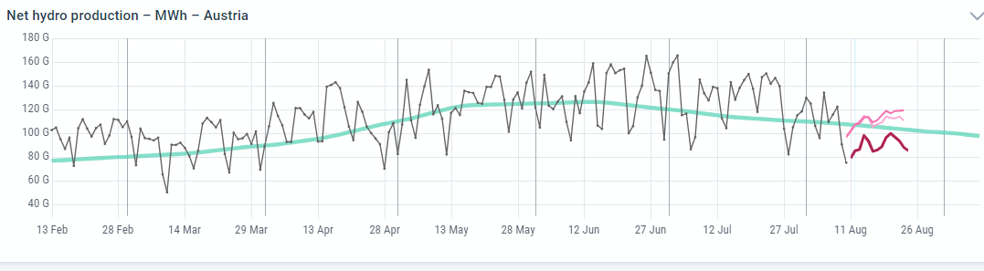
Daily production profiles (GWh/d) across the Alp Region during Q2+Q3
Strong FR production during melting period, IT strong entire period, CH strong July/Aug due to high reservoir filling

Slide 24
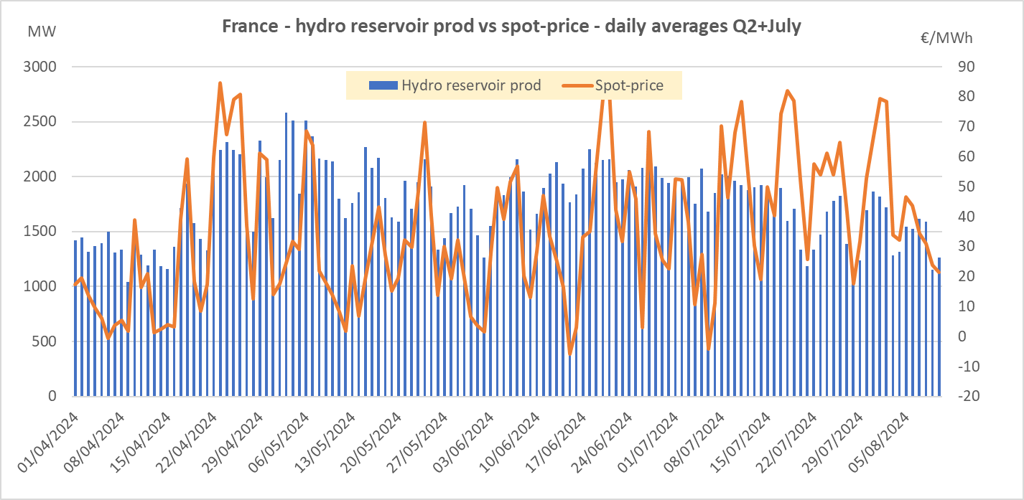
Key hydr. Data CWE/Alp Region Q2 + July
Italy has the strongest hydropower level 126%. France at 123% and 119% during April/May (melting period)
Total prod Alp region Q2+July came out 10 TWh higher than normal (114%)
Correlation Fr reservoir prod and spotprices about 50% - partly because of weekend profiles – difficult to evaluate/define watervalues

Slide 25
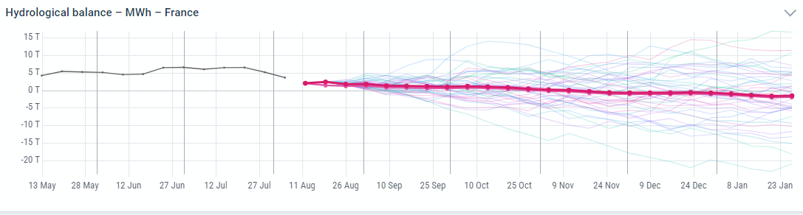
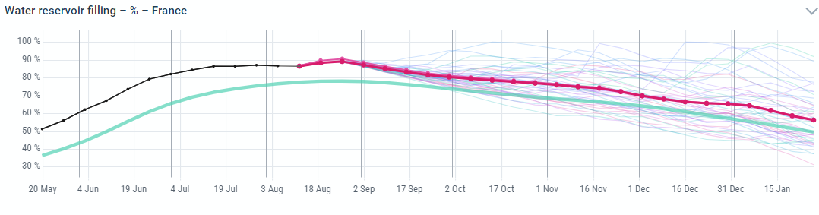
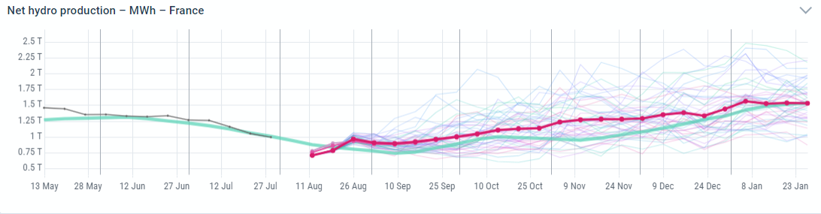
Outlooks France hydr. Balance towards Q4
High reservoir levels supports production pressure during Q3 and start Q4
Average production estimate about 115 % of normal.
Variation band hydr. Balance end Oct = +/- 8 TWh

Slide 26
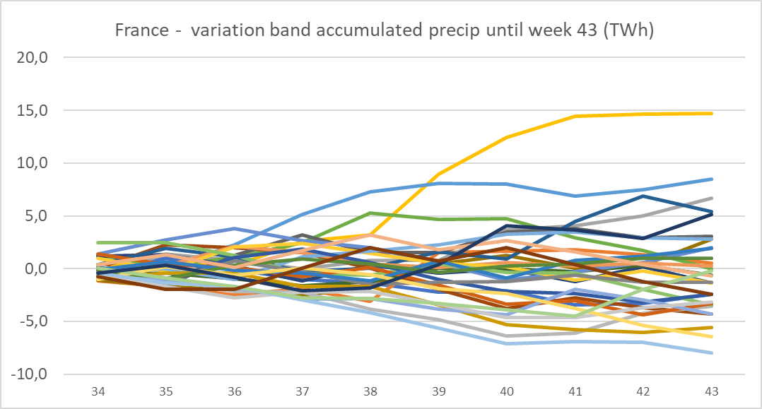
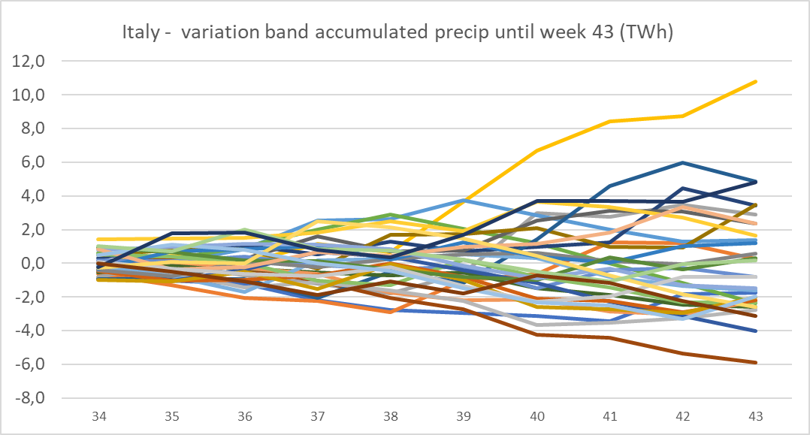
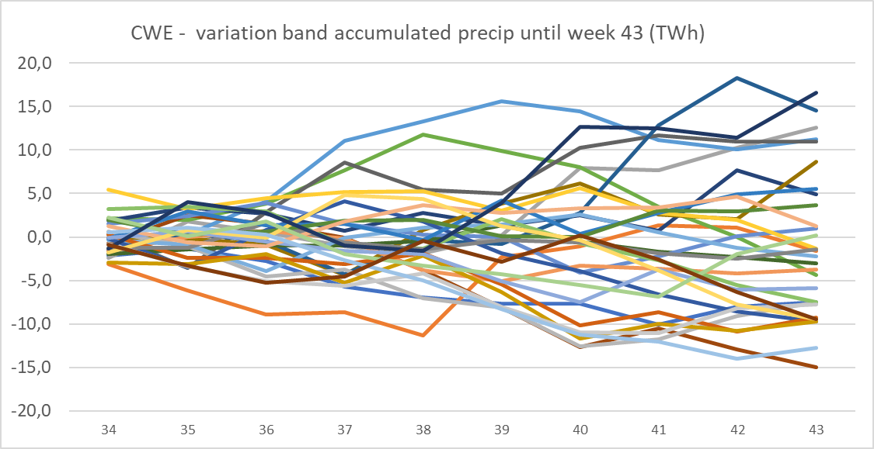
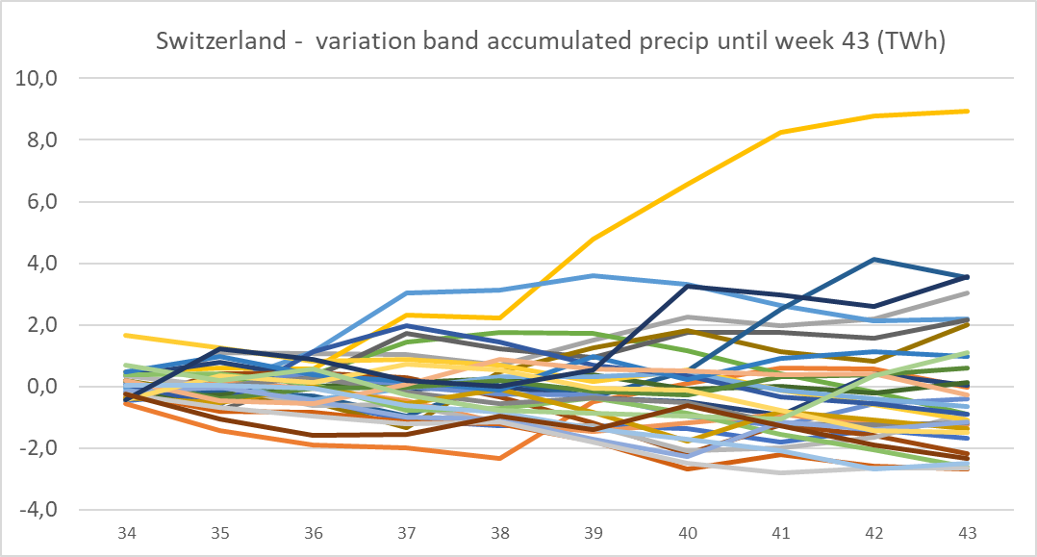
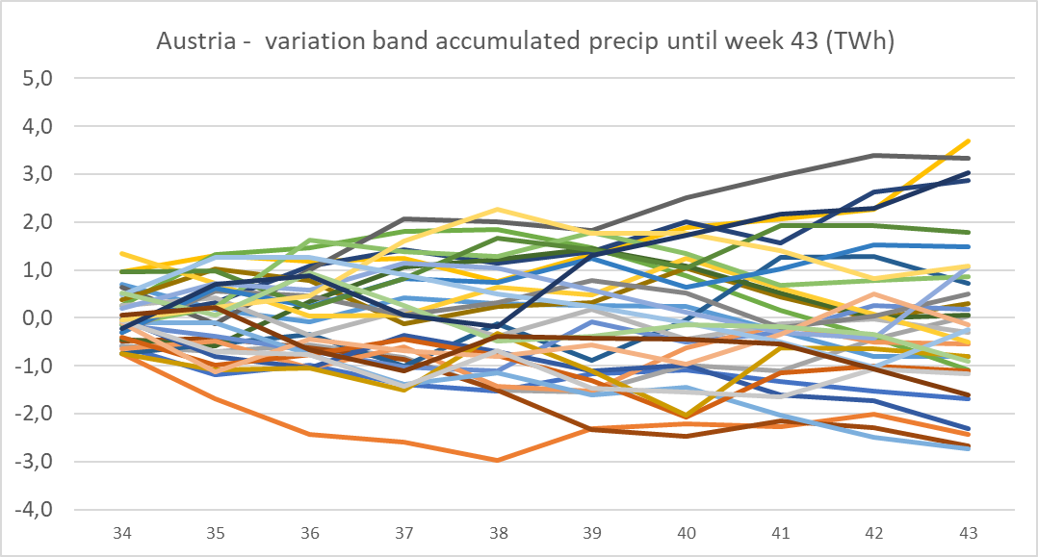
Precipitation uncertainty towards Q4 (accumulated)
Variation band accumulated precipitation until week 43 in the Alp Region
CWE/Alp Region = +/- 15 TWh
Fr = +/- 7 TWh
IT = +/- 6 TWh
CH = +/- 4 TWh
AT = +/- 3 TWh

Slide 27
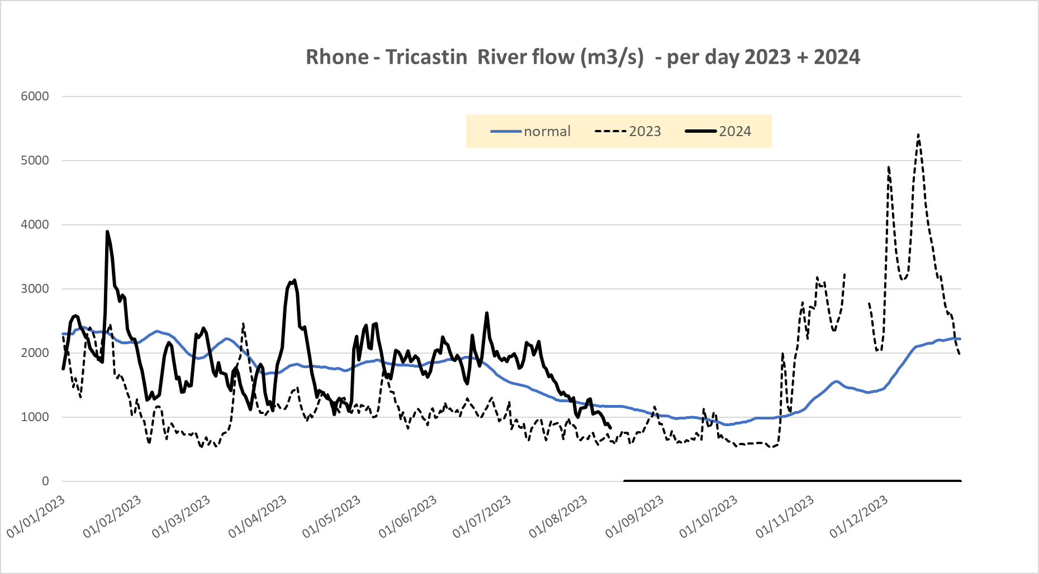
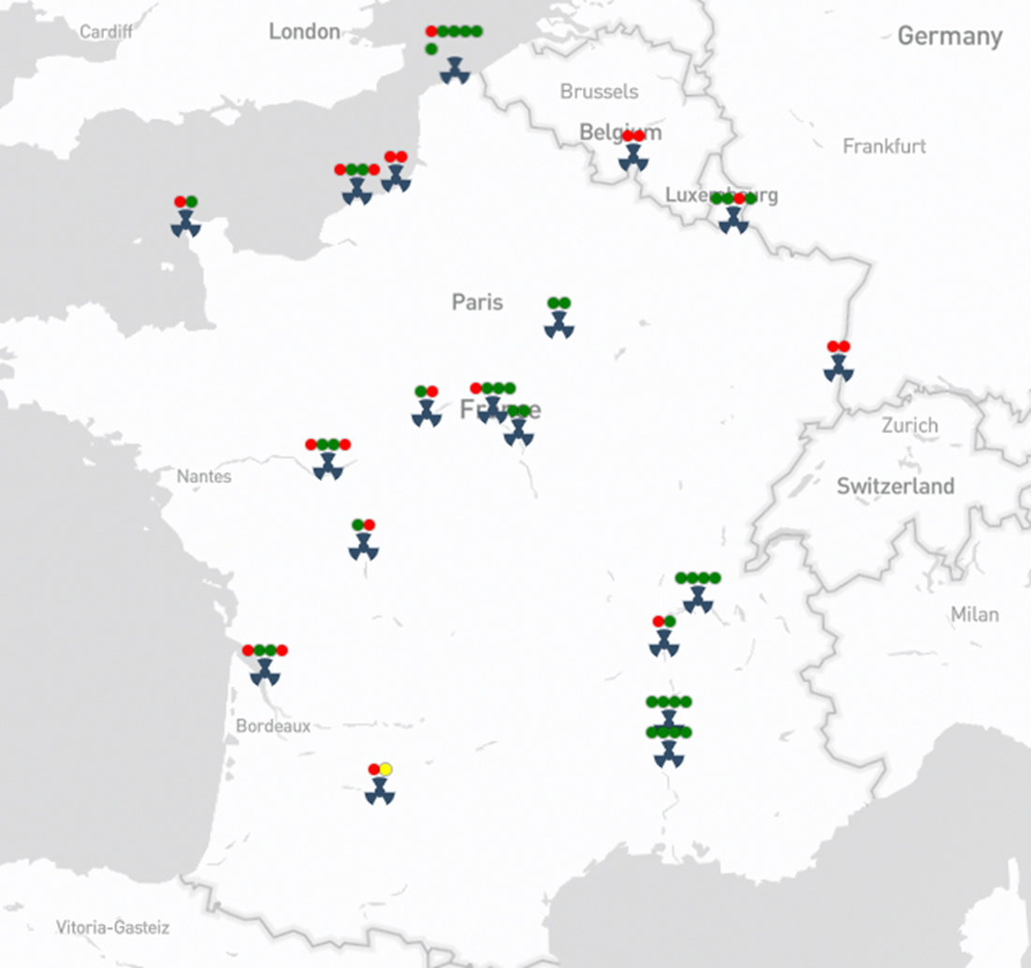
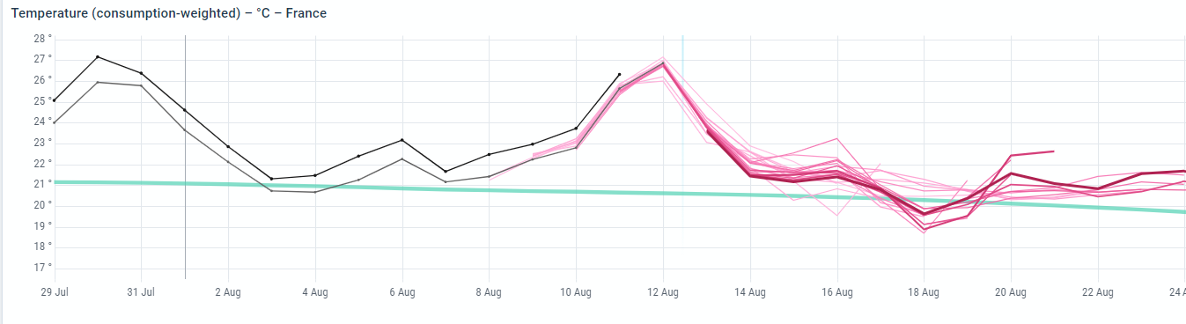
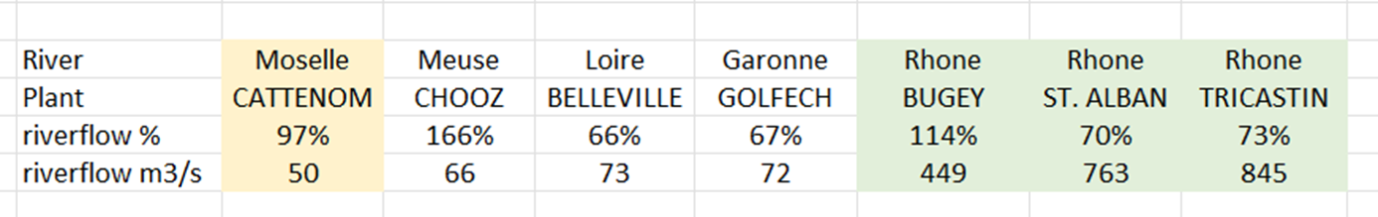
France – decreasing river flows - cooling problems at several nuclear plants (Aug 12th)

Slide 28
Highlights Q2 and outlook Q3
Benelux, Germany
Jean-Paul Harreman

Slide 29
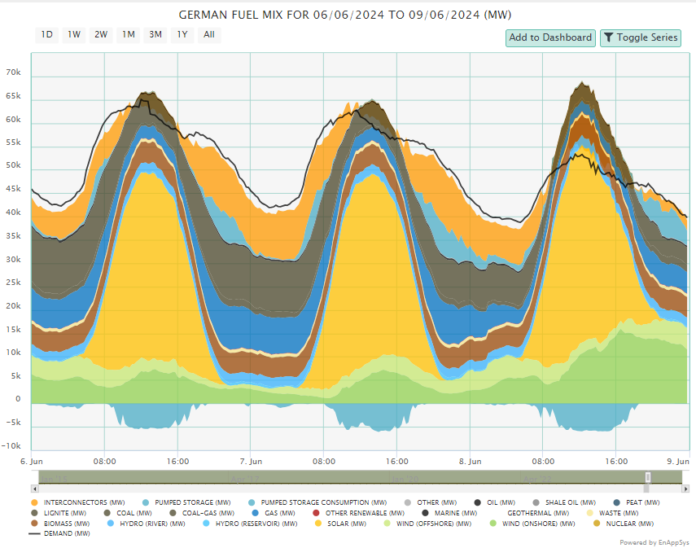
Highest Renewable Outturn Ever,
Lowest Carbon Output
Massive increase Renewables.
Fossil Generation not just lower during solar peak.
Imports during evening peak keeping fossil generation low.

Slide 30
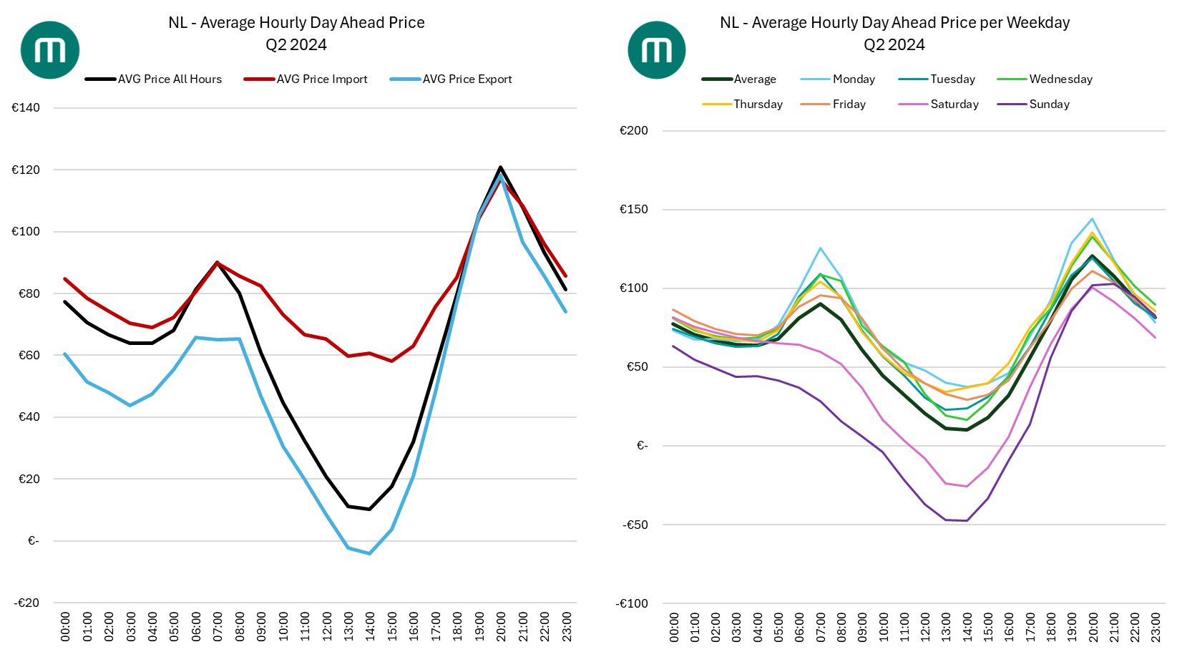
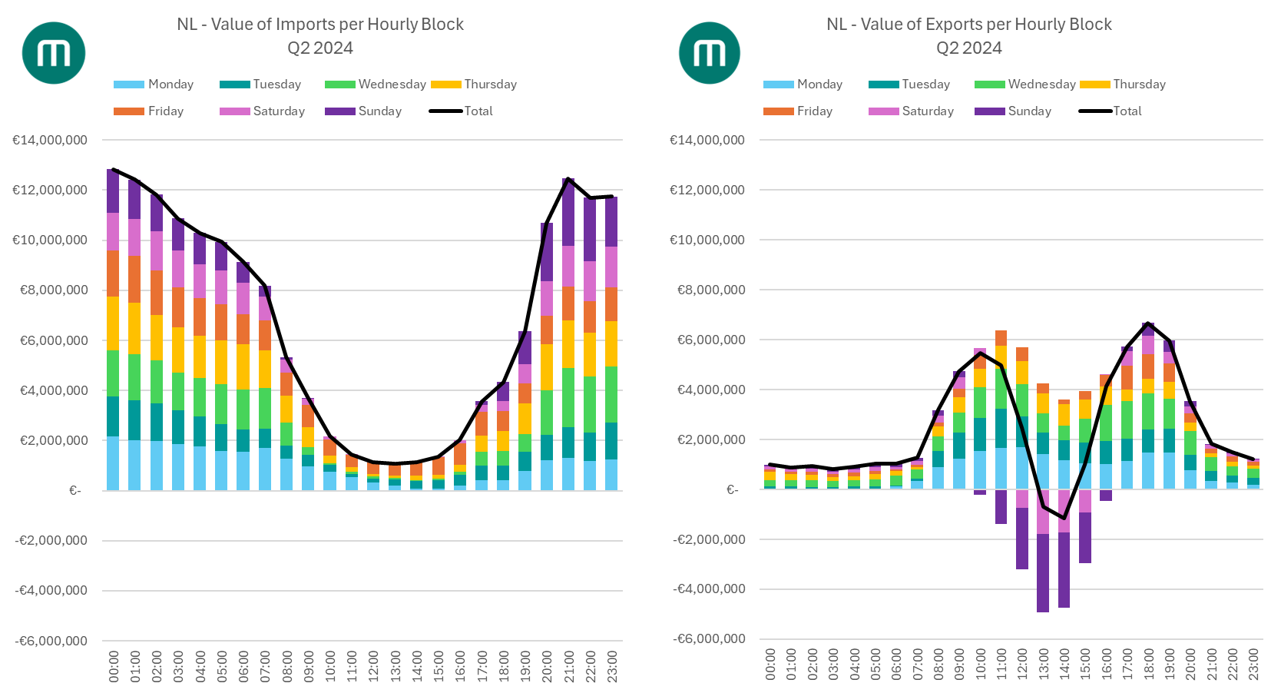
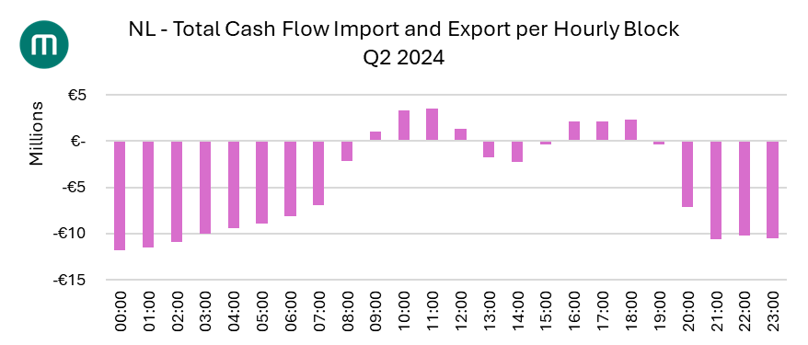
Import/Export Balance
Netherlands large net exporter.
Germany and Belgium importing.
Values of exports lower than the average power price in all 3 countries.
Average export price negative
Average export price negative
Low value of exports
NL: net exporter, but negative cash flow
High value of imports

Slide 31
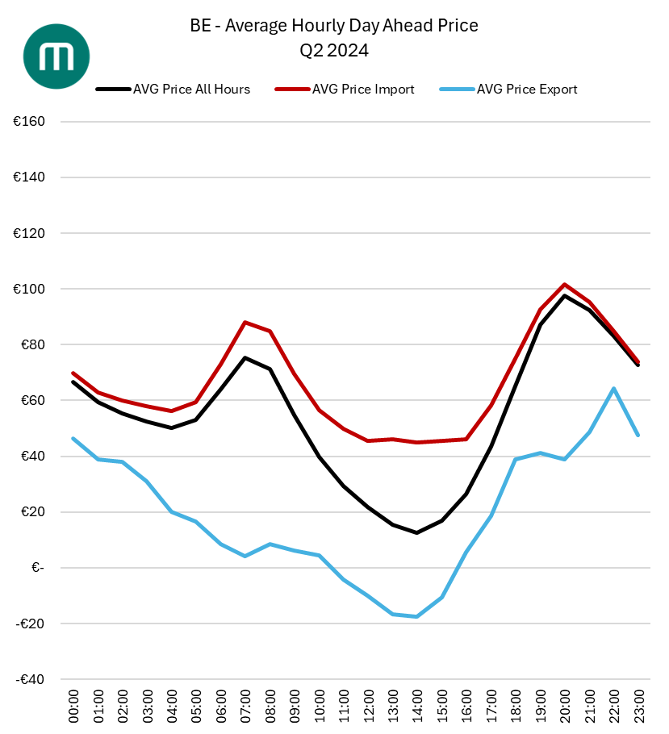
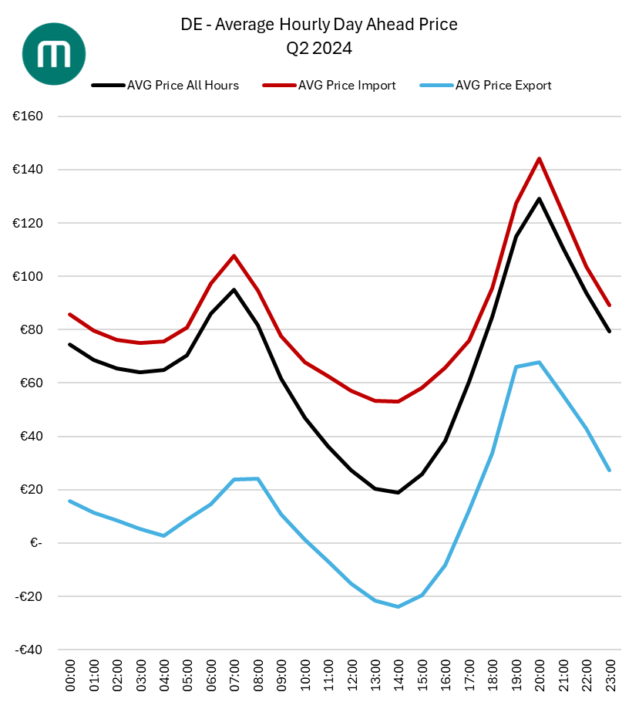
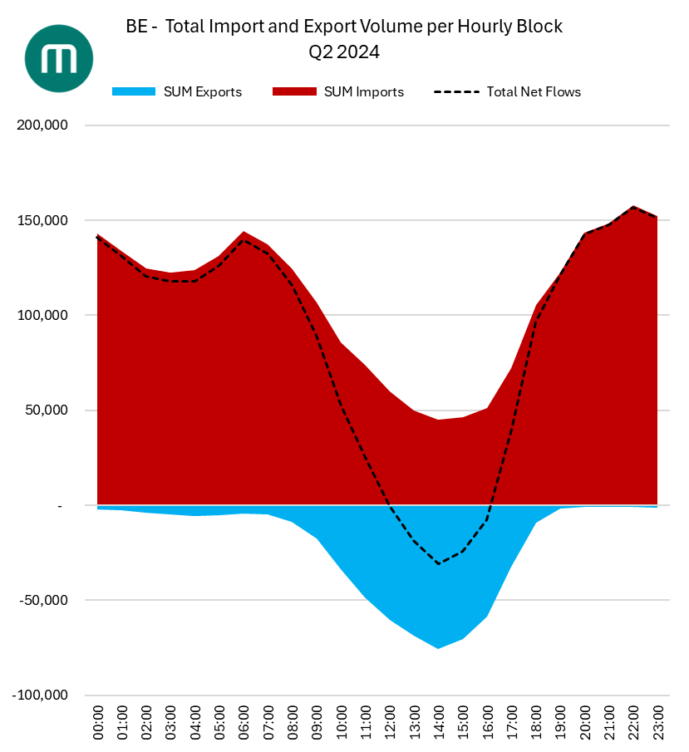
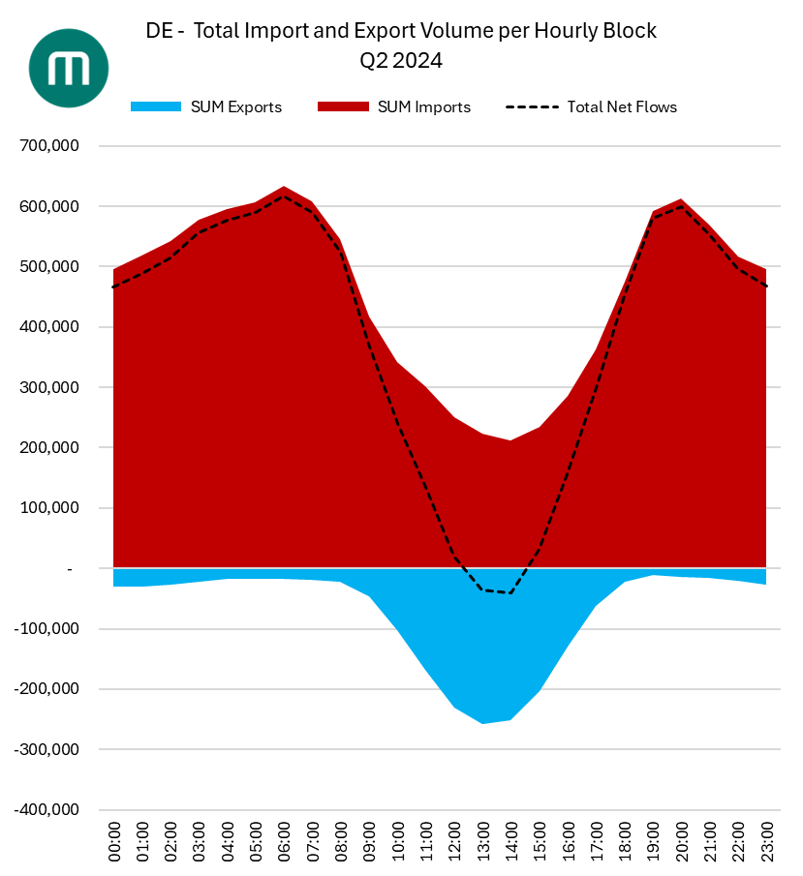
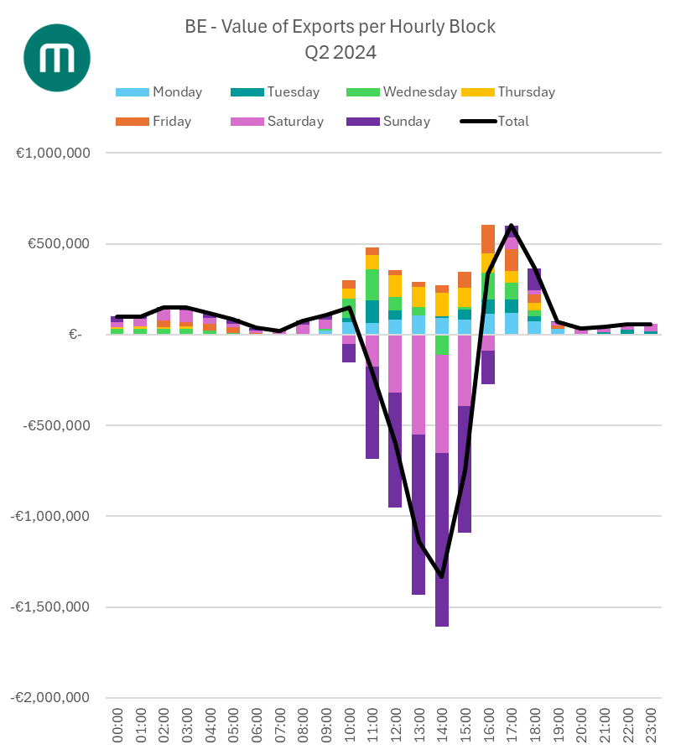



Germany seeing largest spreads and higher peak prices
Import/Export Balance
High price of imports, low price of exports
Not just during weekends

Slide 32
Volatility
Low spinning reserve, high volatility
Belgium: Very negative balancing prices
Netherlands: Many dual balancing prices
Germany: higher predictability of balancing market
Outlook Q3:
Wind will cause more dual pricing in Netherlands
Downward flex remains an issue in Belgium
Gas prices increase uncertainty and potential high-low spread for all 3 countries

Slide 33
SEE
Gábor Szatmári

Slide 34

Front Month Last traded price vs Day-ahead Average Germany – until July2024
2024 – July 2024:
1. For SEE Markets Germany is the traditional benchmark in Western European
2. Monthly avg. of Day-ahead prices show moderate deviation from last forward prices with spot settl. above monthly futures since March – July exception
3. Fuel Mix: Net import + Wind + Solar reduce Gas and Coal Generation to minimum -> how did that compare to recent years

Slide 35

1. Demand destruction bottomed out? – June/July close to 2021/2022 norm. (not weather corrected)
2. Coal gen. On 5-year min., Gas on average except for June/July low
3. Solar gen. Hits record levels with installed cap. growth along with avg. Wind
4. Export/Import shows net importer role of Germany stabilizing after nuclear phase out

Slide 36

Front Month Last traded price vs Day-ahead Average Hungary – until July2024
2024 – July 2024:
1. HUPX monthly avg. spot prices – common benchmark for SEE delivering above front month products since March
2. Monthly avg. of Day-ahead prices show increasing premium to forward prices already from May with July settl. spike

Slide 37

1. Demand destruction bottomed out? – June/July close to 2021/2022 norm. (not weather corrected – July heatwave)
2. Import, traditionnally the second pillar of the Fuel Mix after nuclear is very low since April (see more on that on the next chart)
3. Solar gen. hits record in HU as well – one component of the low Net Import figures (exporting the Solar peaks)
4. Gas and Lignites on multi-year lows – lack of flexibility in the imbalance market – hourly price spikes in the evening (due to sharp gas ramp ups)

Slide 38

1. Looking further into low net import reveleals that imports from WE and export to SEE are both above 3-year max.
2. Exports to RO was than 50% of the total export – more than double than the prev. max since 2021
3. The extreme HU-DE spot benchmark spread was due to general tightness in SEE – price correlation could assist further

Slide 39
Price correlations – DayAhead Hourly Prices
2018 – May 2022
(before FBMC extension to Core and before RO-BG coupling)
June 2022 – Dec 2023
(after FBMC extension to Core)
Most important developments before 2024:
1. Day-ahead flow-based market coupling (DA FBMC) for the Core region went live on June 8th, 2022, for delivery on June 9th, 2022.
2. Price harmonization – stronger correlation was evident, until the end of 2023 – even for non-core markets. (except for PL)
3. Note that due to demand destruction in 2023, the observed pattern could be the relaxed supply-demand price scenario, as 2024 shows a very different image

Slide 40
Price correlations – DayAhead Hourly Prices
2024 Q1
(Correlation decreases slightly
FR,DE – IT-N „decoupling” significant)
2024 - July 2024
(Massive decrease in correlation)
2024 – July 2024:
1. FR, DE price correlations shrinks to min. – AT turned into a land-locked power market island in terms of prices
2. HU formed the strongest correlation with RO,SK,BG so far this year
3. IT-N „decoupled” to previously strongly corrected markets (AT,SL,HR)

Slide 41

1. RO,BG Demand – same pattern of bottoming out in May, than heatwave pushes them to and above the 5-year avg.
2. RO Net Hydro gen. on 5-year low since June – also benchmark to the SEE Hydro levels (see separate hydro comments)
3. BG traditional net exporter volumes are reduced further since 2023 (fuel-switch, renewables pressures lignite gen. profitability)
4. BG - NPP Kozloduy long lasting outage after the scheduled maintenace worsened the supply tightness during warm months

Slide 42


Slide 43
Conclusions
Massive changes in the fuel mix across Europe shifts traditional flows and price correlations in and towards South Europe.
Seasonal demand peaks in June and July highlighted the supply side vulnerability and insufficient interconnector capacities between Western Europe – South Eastern Europe.
FBMC brought price correlation/harmonization until the end of 2023 (under relaxed supply-demand scenario)
In 2024 the harsh price signals of FBMC put those bidding zones and interconnector routes to the spotlight with least robust infrastructure.
The gap between the long-term perspective of social welfare and the currently missing hardware seems too large.

Slide 44
SEE Hydrology Highlights
Eylert Ellefsen

Slide 45



Hydrology – SEE Q2 + Q3 development (Romania as reference)
The precipitation has been very low in the South East Europe since start of Q2, 60% of normal and 5 TWh deficit (7 vs 12 TWh).
The hot summer incident has worsened the hydrological situation, and the spot prices have peaked significantly,

Slide 46

Hydropower inflows and production (weekly)
Despite healthy reservoir fillings by end of Q1, the hydro production curve has followed the inflow levels during Q2 and start of Q3

Slide 47




SEE – hydro reservoir development Q2 + Q3
Reservoir levels very strong Q1, normalized during Q2, outlooks for Q3 sensitive for the downside amid the dry summer

Slide 48


Spotprices during Q2+July , relation to hydro inflows
The charts shows the relation between spot prices and hydropower levels this summer.
Quite linear relation (!) – which has been observed before

Slide 49


SEE hydropower outlooks towards Q4
Focus on continued low inflow scenarios after the hot summer

Slide 50


Short term outlooks for Romania + Serbia – still dry and low inflows/production

Slide 51
Nordic 2024
Highlights so far
Priyanka Shinde

Slide 52
Outline
Energy mix changes in Nordics
Day-ahead Price evolution
Negative prices in the Nordics
Influence on the Cross-border Flows
Market volatility and correlation
Interaction with continental Europe

Slide 53




Fuel mix highlights in Denmark and Norway

Slide 54




Fuel mix highlights in Finland and Sweden

Slide 55



Demand pattern in the Nordics
Average demand was higher in January’24 and February’24 compared to previous years due to extreme winter.
But from March onwards the demand started decreasing due to milder weather and reached similar levels compared to the previous years.

Slide 56




Average Day-ahead market prices in 2024 vs 2023
Notes:
SE3 had the lowest average prices in July since 2020. It was 18 Euro/MWh.
SE4 still more intercoupled with DK1, Dk2 and therefore continental Europe. SVK reduces the capacities from SE4 to SE3 in the direction for N-1 security reasons in case Baltic cable goes out.

Slide 57




Market volatility: Day-ahead price spreads
Notes:
DA price spreads in DK1, DK2, SE4 increasing during spring and summer this year compared to last year. While SE1, SE2, SE3 price spreads are reducing…
FI very volatile this year…

Slide 58



Negative Day-ahead prices statistics
Number of hours with negative prices in 2024
Number of hours with negative prices in 2023
-0.02
-2.16
-3.1
-3.75
-0.02
-3.07
-2.16
-3.75
-1.95
-2.18
-5.43
-2.62
-7.14
-7.14
-5.37
-3.09
-3.87
-3.92
-5.37
-4.74
-26
-5.33
-5.3
How negative are the average prices?
Notes:
Low Gos prices leading to not so low negative prices

Slide 59




Import/exports for NO3 and NO4
2024
2023
Mostly importing throughout
Mix of import and export during summer
NO3
Several hours of imports during summer
Mostly exporting throughout
NO4

Slide 60


Import/exports for Denmark
Denmark majorly importing this year especially from spring onwards.
2024
There were periods of exports from Denmark even during spring and summer last year.
2023

Slide 61


Import/exports for Finland
Outage of Olkiluoto 3 from March to mid May 2024 linked to large imports in Finland.
2024
In June/July, Finland has been exporting but the volumes are limited due to prolonged outage on Estlink 2.
Finland started exporting after Olkiluoto 3 came online in 2023
2023

Slide 62


DA prices until July 2024
Price correlation within Nordics and Germany
DA prices until July 2024
DA prices until July 2023
Weaker correlation with Germany compared to last year

Slide 63


DA prices until July 2024
Price difference with German Day-ahead market
The hourly Day-ahead price difference between Germany and NO2 has been increasing since March/April 2024 and has been the higher than last year for the entire period until July.
Stronger correlation of DK1 and DK2 prices this year leads to similar price difference with Germany in contrast to last year.
Significant price difference with Denmark in June 2024 compared to the previous year.
* Positive difference indicates that German DA prices are higher than Nordic bidding zones

Slide 64




DA prices until July 2024
Price difference and flows with Germany
With
NO2
With
NO2
With
DK1
With
DK1
* All green circles denotes flows (exports from Germany to NO2 or DK1)

Slide 65
Conclusions
Average Day ahead prices lower in all the Nordic countries after the extreme winter months were over.
Demand was higher compared to previous years during extreme winter months and started decreasing since March reaching similar levels as previous years.
More number of negative price hours in most bidding zones compared to last year. The average negative prices are not as low due to falling GO prices.
Flows from continental Europe are partly related to the lower prices.
Additionally, increase in nuclear capacity, renewables, interconnector unavailability is partly responsible for the lower prices.
Finland was the most volatile out of all the Nordic bidding zones in terms of day-ahead market prices.

Slide 66
Nordic Hydrology Highlights
Eylert Ellefsen

Slide 67



Hydrology – Nordic Q2 + Q3 development
The hydr. Balance started at Q2 period at – 6 TWh.
A very warm and dry May, hydr. balance declined, hydro reservoir levels increased though by strong inflows. June came out very wet, hydr. Balance nearly normalized. July drier than normal, current outlooks nearly normalized situation.

Slide 68


Hydropower inflows and production (weekly)
Early melting and very strong inflows during May (warm and dry) caused moderate inflows during June despite the wet period. Hydro production close to normal due to strong reservoir capacity, variations influenced by both NP and DE windpower

Slide 69
Hydropower inflows and production (weekly)
Early melting and very strong inflows during May (warm and dry) caused moderate inflows during June despite the wet period. Hydro production close to normal due to strong reservoir capacity, variations influenced by both NP and DE windpower

Slide 70



Spot prices and watervalues during Q2 until end July
Nordic spotprices determined by hydropower and their watervalues.
The watervalues are determined by NP FWD-prices, hydrological balance, NP powerbalance and Continental spotprices
Illustrations of hourly watervalues week 17 (high) and week (27)

Slide 71

Hydr. Balance main pricedriver in NP FWD market
See chart hydr. Balance (inversed) vs SRMC Gas and NP FWD sept-24
As the NP powermarket is nearly decoupled from the Contintental markets, the hydr. balance is the main price-driver for the Q3-FWD products, see correlations
Corr SRMC Gas = 0,22
Corr Hydr. Bal. = -0,68

Slide 72


Outlooks NP hydr. Balance towards Q4
By end of October (week 43) the variation band of hydr. Balance +/- 12 TWh, historical upper or lower levels can still be reached
Scenarios based on 40 weather years of precipitation (see more EQ web)

Slide 73


NP Inflow and snow/ground scenarios towards Q4 – based on 40 weather years

